Slide 1
Course code : CSE3009 Course title : No SQL Data Bases Module : 1 Topic : 7
BigData stack

Slide 2
Objectives
This session will give the knowledge about
Big Data concept
BigData stack
Position of NoSQL in BigData stack

Slide 3
What is Big Data
Data which are very large in size is called Big Data.
Normally we work on data of size MB(WordDoc ,Excel) or maximum GB but data in Peta bytes i.e. 10^15 byte size is called Big Data.
Big data is a great quantity of diverse information that arrives in increasing volumes and with ever-higher velocity.
Big data can be structured (often numeric, easily formatted and stored) or unstructured (more free-form, less quantifiable).

Slide 4
What is Big Data
Nearly every department in a company can utilize findings from big data analysis, but handling its clutter and noise can pose problems.
Big data can be collected from publicly shared comments on social networks and websites, voluntarily gathered from personal electronics and apps, through questionnaires, product purchases, and electronic check-ins.
Big data is most often stored in computer databases and is analyzed using software specifically designed to handle large, complex data sets.

Slide 5
Sources of Big Data
Social networking sites: Facebook, Google, LinkedIn all these sites generates huge amount of data on a day to day basis as they have billions of users worldwide.
E-commerce site: Sites like Amazon, Flipkart, Alibaba generates huge amount of logs from which users buying trends can be traced.
Weather Station: All the weather station and satellite gives very huge data which are stored and manipulated to forecast weather.
Share Market: Stock exchange across the world generates huge amount of data through its daily transaction.

Slide 6
Types Of Big Data
Structured: Any data that can be stored, accessed and processed in the form of fixed format is termed as a ‘structured’ data.
Unstructured: Any data with unknown form or the structure is classified as unstructured data.
Semi-structured: Semi-structured data can contain both the forms of data. We can see semi-structured data as a structured in form but it is actually not defined like DBMS. Example of semi-structured data is a data represented in an XML file.

Slide 7
Characteristics Of Big Data
Volume – The name Big Data itself is related to a size which is enormous. Size of data plays a very crucial role in determining value out of data.
Variety – Variety refers to heterogeneous sources and the nature of data, both structured and unstructured.
Velocity – The term ‘velocity’ refers to the speed of generation of data.
Variability – This refers to the inconsistency which can be shown by the data at times, thus hampering the process of being able to handle and manage the data effectively.

Slide 8
How to deal with Bigdata
Storage: This huge amount of data, Hadoop uses HDFS (Hadoop Distributed File System) which uses commodity hardware to form clusters and store data in a distributed fashion. It works on Write once, read many times principle.
Processing: Map Reduce paradigm is applied to data distributed over network to find the required output.
Analyze: Pig, Hive can be used to analyze the data.
Cost: Hadoop is open source so the cost is no more an issue.

Slide 9
Understanding Big Data Stack
There are many Big Data Solution stacks.
The first and most powerful stack is Apache Hadoop and Spark together. While Hadoop provides storage for structured and unstructured data, Spark provides the computational capability on top of Hadoop.
The second way could be to use Cassandra or MongoDB.
The third could be to use Google Compute Engine or Microsoft Azure. In such cases, you would have to upload your data to Google or Microsoft which may not be acceptable to your organization sometimes.

Slide 10
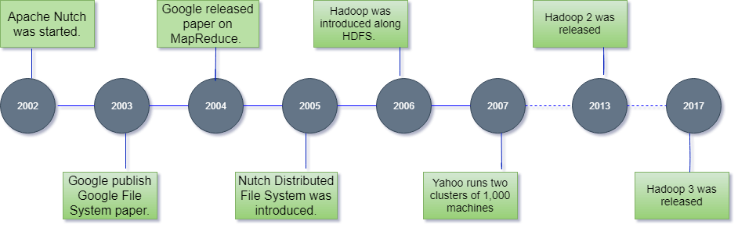
What is Hadoop?
Hadoop was created by Doug Cutting in order to build his search engine called Nutch. He was joined by Mike Cafarella.
Hadoop was based on the three papers published by Google: Google File System, Google MapReduce, and Google Big Table. It is named after the toy elephant of Doug Cutting’s son.

Slide 11
Characteristics
1. Distributed – They should be able to utilize multiple machines in order to solve a problem.
2. Scalable – If needed it should be very easy to add more machines.
3. Reliable – If some of the machines fail, they should still work fine. These are the three criteria for all the projects or components under Apache Hadoop.

Slide 12
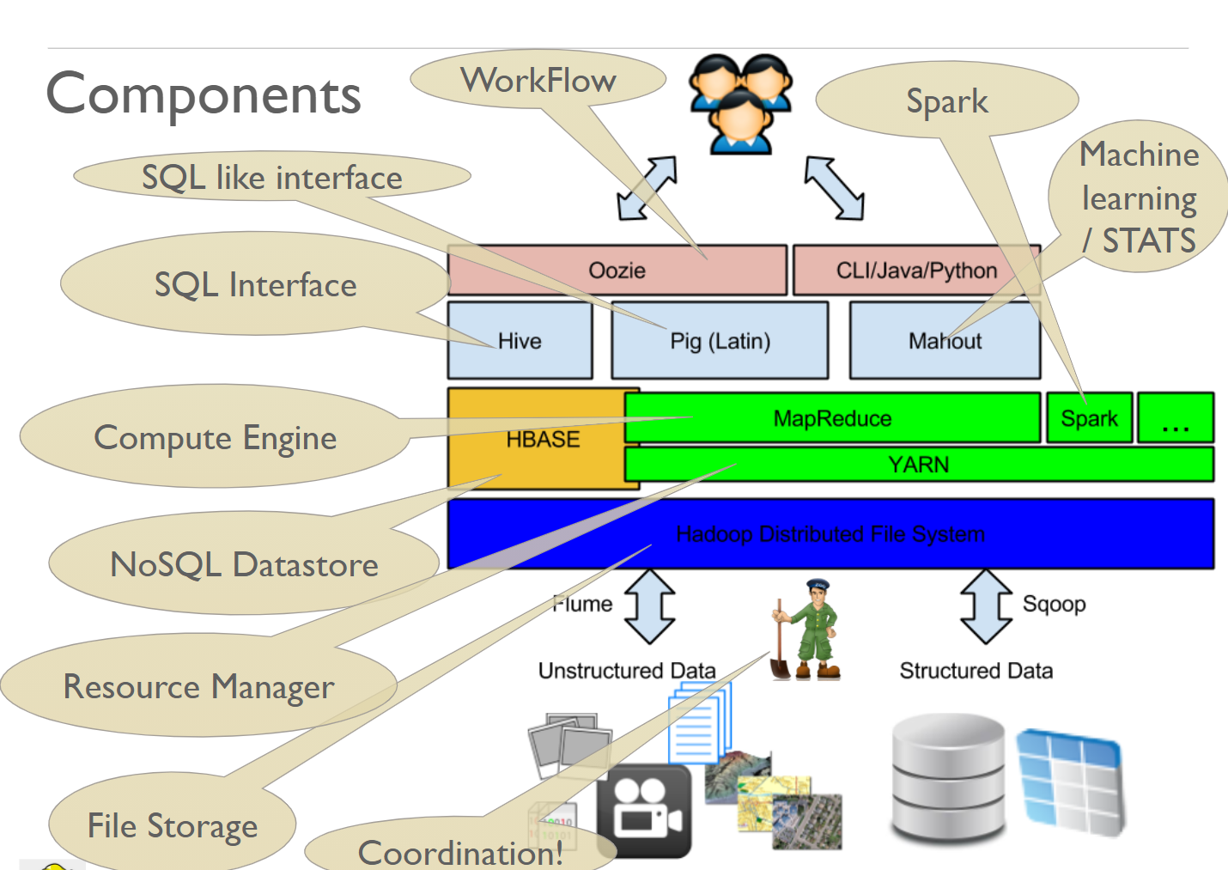
Components of the Hadoop ecosystem

Slide 13
Components of the Hadoop ecosystem
HDFS
HDFS or Hadoop Distributed File System is the most important component because the entire eco-system depends upon it. It is based on Google File System.
It is basically a file system that runs on many computers to provide huge storage. If you want to store petabytes of data in the form of files, you can use HDFS.

Slide 14
Components of the Hadoop ecosystem
YARN
YARN or yet another resource negotiator keeps track of all the resources (CPU, Memory) of machines in the network and run the applications. Any application which wants to run in distributed fashion would interact with YARN.
HBase
HBase provides huge storage in the form of a database table. So, to manage humongous records, you would like to use HBase.

Slide 15
Components of the Hadoop ecosystem
MapReduce
MapReduce is a framework for distributed computing. It utilizes YARN to execute programs and has a very good sorting engine.
You write your programs in two parts Map and reduce. The map part transforms the raw data into key-value and reduce part groups and combines data based on the key. We will learn MapReduce in details later.

Slide 16
Components of the Hadoop ecosystem
Spark
Spark is another computational framework similar to MapReduce but faster and more recent. It uses similar constructs as MapReduce to solve big data problems. Spark has its own huge stack.
Hive
Writing code in MapReduce is very time-consuming. So, Apache Hive makes it possible to write your logic in SQL which internally converts it into MapReduce.

Slide 17
Components of the Hadoop ecosystem
Pig (Latin)
Pig Latin is a simplified SQL like language to express your ETL (Extract, Transform, Load) needs in stepwise fashion. Pig is the engine that translates Pig Latin into Map Reduce and executes it on Hadoop.
Mahout
Mahout is a library of machine learning algorithms that run in a distributed fashion. mahout breaks down work such that it gets executed on MapReduce running on many machines.

Slide 18
Components of the Hadoop ecosystem
Apache ZooKeeper
Apache Zookeeper is an independent component which is used by various distributed frameworks such as HDFS, HBase, Kafka, YARN.
It is used for the coordination between various components. It provides a distributed configuration service, synchronization service, and naming registry for large distributed systems.

Slide 19
Components of the Hadoop ecosystem
Flume (Data aggregator)
Flume makes it possible to continuously pump the unstructured data from many sources to a central source such as HDFS.
If you have many machines continuously generating data such as Webserver Logs, you can use flume to aggregate data at a central place such as HDFS.

Slide 20
Components of the Hadoop ecosystem
SQOOP
Sqoop is used to transport data between Hadoop and SQL Databases. Sqoop utilizes MapReduce to efficiently transport data using many machines in a network.
Oozie (Workflow managment)
A typical project might involve importing data from SQL Server, running some Hive Queries, doing predictions with Mahout, Saving data back to an SQL Server. This kind of workflow can be easily accomplished with Oozie.

Slide 21
NoSQL way to deal with Big Data
When we say “big data”, many think of the Hadoop technology stack. Is this the big data stack? Well, not anymore. Here are big data initiatives based on other technologies:
NoSQL databases like MongoDB, PostgreSQL and Cassandra running huge volumes of data.
Cloud-based data warehouses which can hold petabyte-scale data with blazing fast performance.
Even traditional databases store big data—for example, Facebook uses a sharded MySQL architecture to store over 10 petabytes of data.

Slide 22
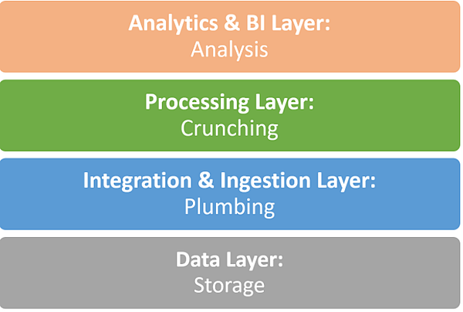
NoSQL - Big Data Technology Stack

Slide 23
Data Storage Systems
Hadoop HDFS - the classic big data file system. It became popular due to its robustness and limitless scale on commodity hardware. However, it requires a specialized skillset and complex integration of a myriad open source components.
Amazon S3 - create buckets and load data using a variety of integrations, with 99.99% guaranteed durability. S3 is simple, secure, and provides a quick and cheap solution for storing limitless amounts of big data.
MongoDB - a open source document-based database, built to handle data at scale with proven performance. However, some have criticized its use as a first-class data storage system, due to its limited analytical capabilities and no support for transactional data.

Slide 24
Big Data Ingestion Tools
Stitch - a lightweight ETL (Extract, Transform, Load) tool which pulls data from multiple pre-integrated data sources, transforms and cleans it as necessary. Stitch is easy to setup, seamless and integrates with dozens of data sources. However, it does not support data transformations.
Blendo - a cloud data integration tool that lets you connect data sources with a few clicks, and pipe them to Amazon Redshift, PostgreSQL, or MS SQL Server. Blendo provides schemas and optimization for email marketing, eCommerce and other big data use cases.
Apache Kafka - an open source streaming messaging bus that can creates a feed from your data sources, partitions the data, and streams it to a passive listener. Apache Kafka is a mature and powerful solution used in production at huge scale. However it is complex to implement, and uses a messaging paradigm most data engineers are not familiar with.

Slide 25
Data Processing Tools
Apache Spark - like the old Map/Reduce but over 100X faster. Runs parallelized queries on unstructured, distributed data in Hadoop, Mesos, Kubernetes and elsewhere. Spark also provides a SQL interface, but is not natively a SQL engine.
PostgreSQL - many organizations pipe their data to good old Postgres to facilitate queries. PostgreSQL can be scaled by sharding or partitioning and is very reliable.
Sqream - fully relational SQL database with automatic tuning, ultra fast performance, compression and scalability.
Amazon Redshift - darling of the data industry, a cloud-based data warehouse offering blazing query speeds that can be used as a relational database.

Slide 26
BI / Analytics Tools
Tableau - powerful BI and data visualization tool, which connects to your data and allows you to drill down, perform complex analysis, and build charts and dashboards.
Chartio - cloud BI service allowing you to connect data sources, explore data, build SQL queries and transform the data as needed, and create live auto-refreshing dashboards.
Looker - cloud-based BI platform that lets you query and analyze large data sets via SQL-define metrics once set up visualizations that tell a story with your data.

Slide 27
Summary
This session will give the knowledge about
Big Data concept
BigData stack
Position of NoSQL in BigData stack

